Slide 1
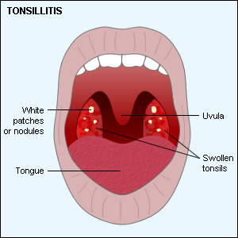
Tonsils

Slide 2
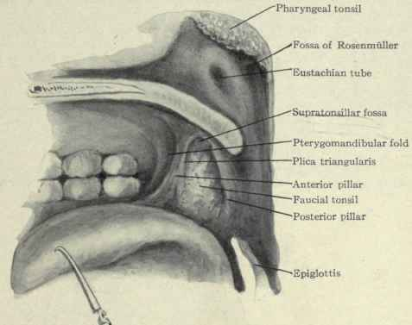
Tonsils are large lymphoid tissue situated in the lateral wall of the oropharynx.
They form lateral part of the Waldeyer's ring.
Tonsil occupies the tonsillar fossa between diverging palato-pharyngeal and palatoglossal folds

Slide 3
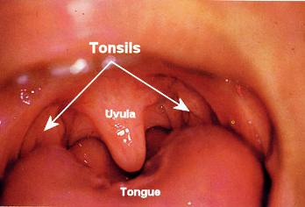
Tonsil has two surfaces, medial and lateral; two borders anterior and posterior; two poles upper and lower; two developmental folds plica triangulris and plica semilumris; and one cleft intratonsillar cleft.
Medial surface is covered by squamous epithelium and presents 15-20 crypts usually plugged with epithelial and bacterial debris

Slide 4
Lateral surface extends deep to surrounding boundaries. It is coated with a fibrous sheet, an extension of pharyngobasilar fascia called capsule of the tonsil.
The capsule is loosely attached to the muscular wall but antero-inferiorly it is attached firmly to the side of the tongue just in front of insertion of palatoglossus and palatopharyngeus muscles

Slide 5
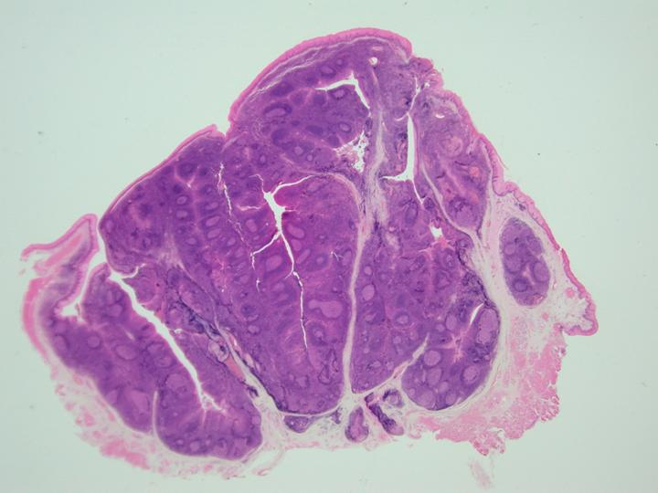
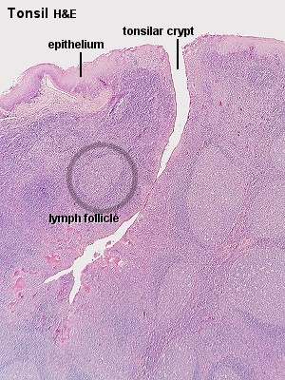
Tonsils-Gross & Microscopic

Slide 6
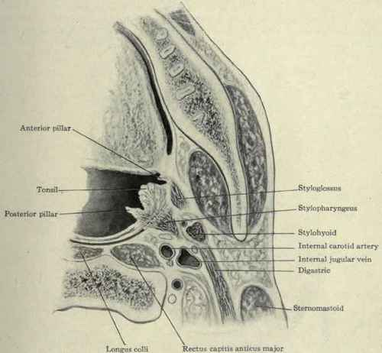
Bed of the tonsil comprises of
Loose aerolar tissue
Pharyngobasilar fascia
Superior constrictor muscle
:

Slide 7
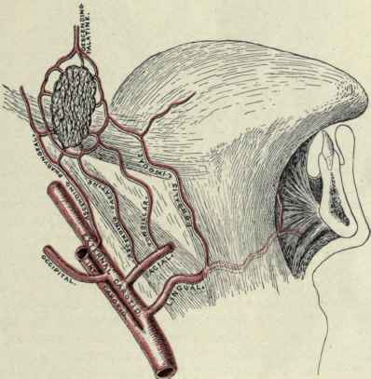
Blood Supply of tonsil
Tonsillar branch of the dorsal lingual
Ascending palatine branch of facial artery
Tonsillar branch of facial artery
Ascending pharyngeal
Descending palatine

Slide 8
Acute tonsillitis
Mainly a disease of childhood but is also seen in adults.
May occur primarily as infection of the tonsils themselves or may secondarily occur as a result of URTI following viral infection.
Organisms:
Beta-haemolytic streptococcus
Staphylococcus
Haemophilus influenzae
Pneumococcus
The part played by viruses in acute tonsillitis is unknown.

Slide 9
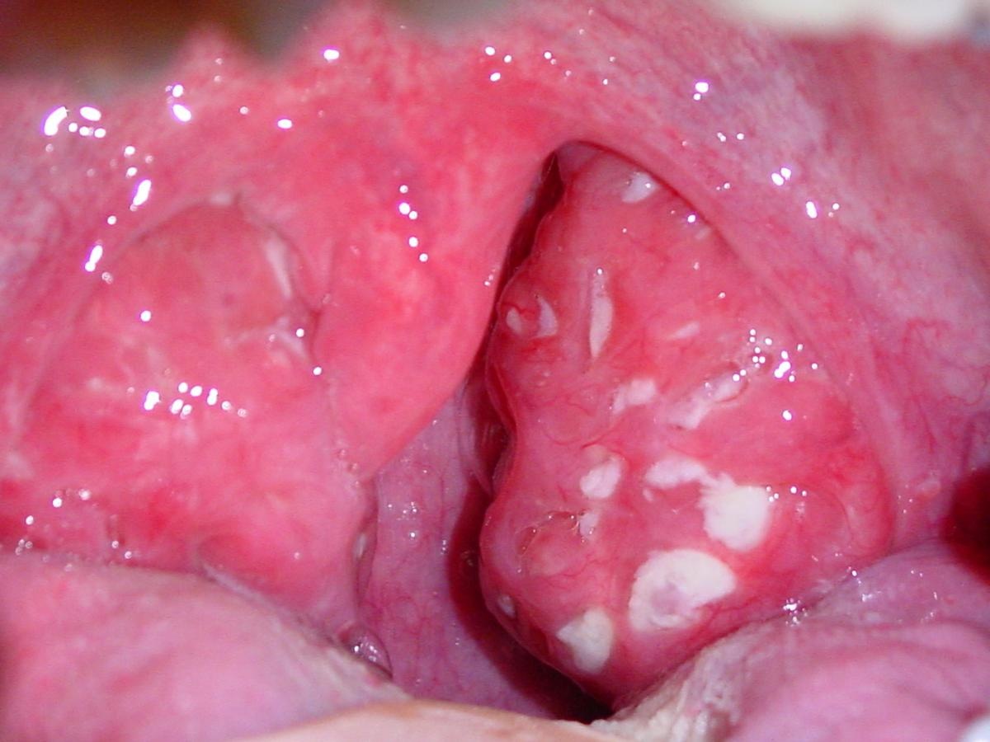
Pathology-1
The process of inflammation originating within the tonsil is accompanied by hyperemia and oedema with conversion of lymphoid follicles in to small abscesses which discharge into crypts.
When inflammatory exudate collects in tonsillar crypts these present as multiple white spots on inflamed tonsillar surface giving rise to clinical picture of follicular tonsillitis.

Slide 10
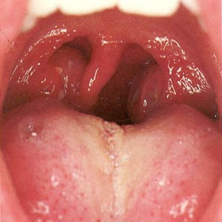
Catarrhal tonsillitis
When tonsils are inflamed as part of the generalised infection of the oropharyngeal mucosa it is called catarrhal tonsillitis.

Slide 11
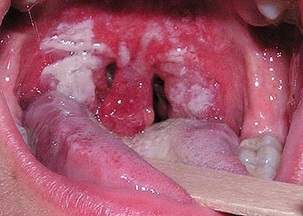
Membranous tonsillitis.
Some times exudation from crypts may coalesce to form a membrane over the surface of tonsil, giving rise to clinical picture of membranous tonsillitis.

Slide 12
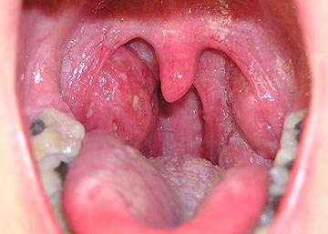
Parenchymatous tonsillitis
When the whole tonsil is uniformly congested and swollen it is called acute parenchymatous tonsillitis

Slide 13
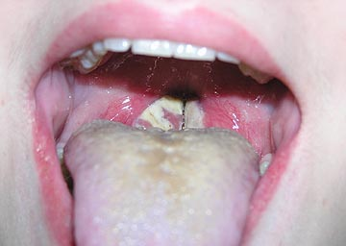
Differential Diagnosis
Scarlet fever
Diphtheria
Vincent's infection
Agranulocytosis
Glandular fever
Complications
Chronic tonsillitis
Peri tonsillar Abscess
Para Pharyngeal Space Abscess
Acute SOM
Acute nephritis
RHEUMATIC Fever
Laryngeal edema
Septicemia

Slide 14
Symptoms:
Discomfort in throat
Difficulty in swallowing
Generalised body ache
Fever
Earache and Thick speech
Signs:
Swollen congested tonsils with exudates
Enlarged tender Jugulo-diagastric lymph nodes

Slide 15
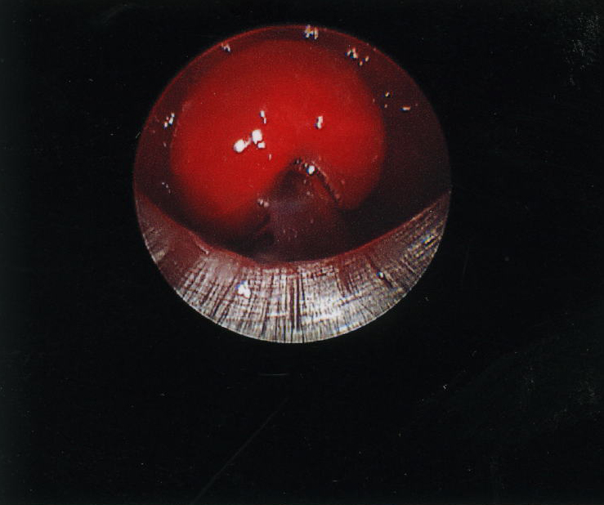
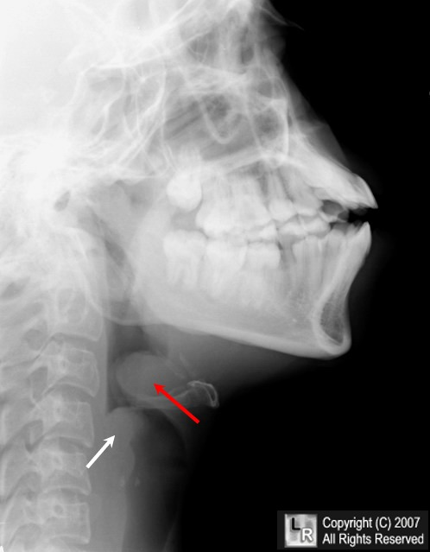
Complications-1
Local: Severe swelling with spread of infection and inflammation to the hypopharynx and larynx may occasionally produce increasing respiratory obstruction, although it is very rare in uncomplicated acute tonsillitis.

Slide 16
Complications-2
Peritonsillar abscess is one of the complications of acute tonsillitis and its development means that infection has spread outside tonsillar capsule.
Spread of infection from tonsil or more usually from a peritonsillar abscess through the superior constrictor muscle of the pharynx first results in cellulitis of the neck and later in parapharyngeal space abscess.

Slide 17
Complications-3
The systemic or general complications of acute tonsillitis are rare and almost confined to childhood.
Septicemia: Untreated acute tonsillitis can result in septicemia with septic abscesses, septic arthritis and meningitis

Slide 18
Complications-4
Acute rheumatic fever and glomerulonephritis:
These diseases are of unknown aetiology and follow infection with Beta-haemolytic streptococcus. The current belief is that antibodies produced against the streptococcus may in some instances cross react with patient’s own tissue.
Thus the effect on tissue may be an arthritis, endocarditis or myocarditis or a dermatitis or rheumatic chorea (inflammation of cerebral cortex and basal ganglia).

Slide 19
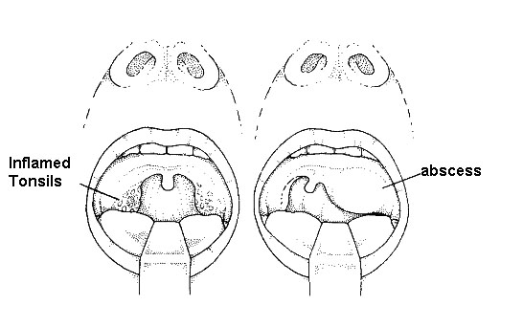
Peritonsillar Abscess or Quinsy
It is a collection of pus between fibrous capsule of the tonsil usually at its upper pole and the superior constrictor muscle of pharynx.
It usually occurs as a complication of the acute tonsillitis or it may apparently arise de novo with no preceding tonsillitis.

Slide 20
Bacteriology
The bacteriology of acute tonsillitis and peritonsillar abscess is different although one is a complication of the other.
The bacteriology of the quinsy is characterized by mixed flora with multiple organisms both aerobic and anaerobic.

Slide 21
Clinical Features
Fit and young adult with a prior history of repeated attacks of acute tonsillitis.
Preceded by a sore throat for 2-3 days which gradually becomes severe and unilateral.
At this stage patient is ill with fever, often a headache and severe throat pain made worse by swallowing.
There might be referred otalgia, pain and swelling in the neck due to infective lymphadenopathy. The patient’s voice develops a characteristic ‘plummy’ quality.

Slide 22
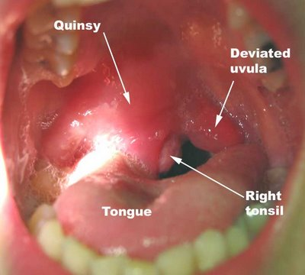
Signs
Ill looking patient
Pyrexia
Often with severe trismus
Striking asymmetry with oedema and hyperaemia of the soft palate.
Enlarged hyperaemic and displaced tonsil
Usually enlarged lymph nodes in JD region.

Slide 23

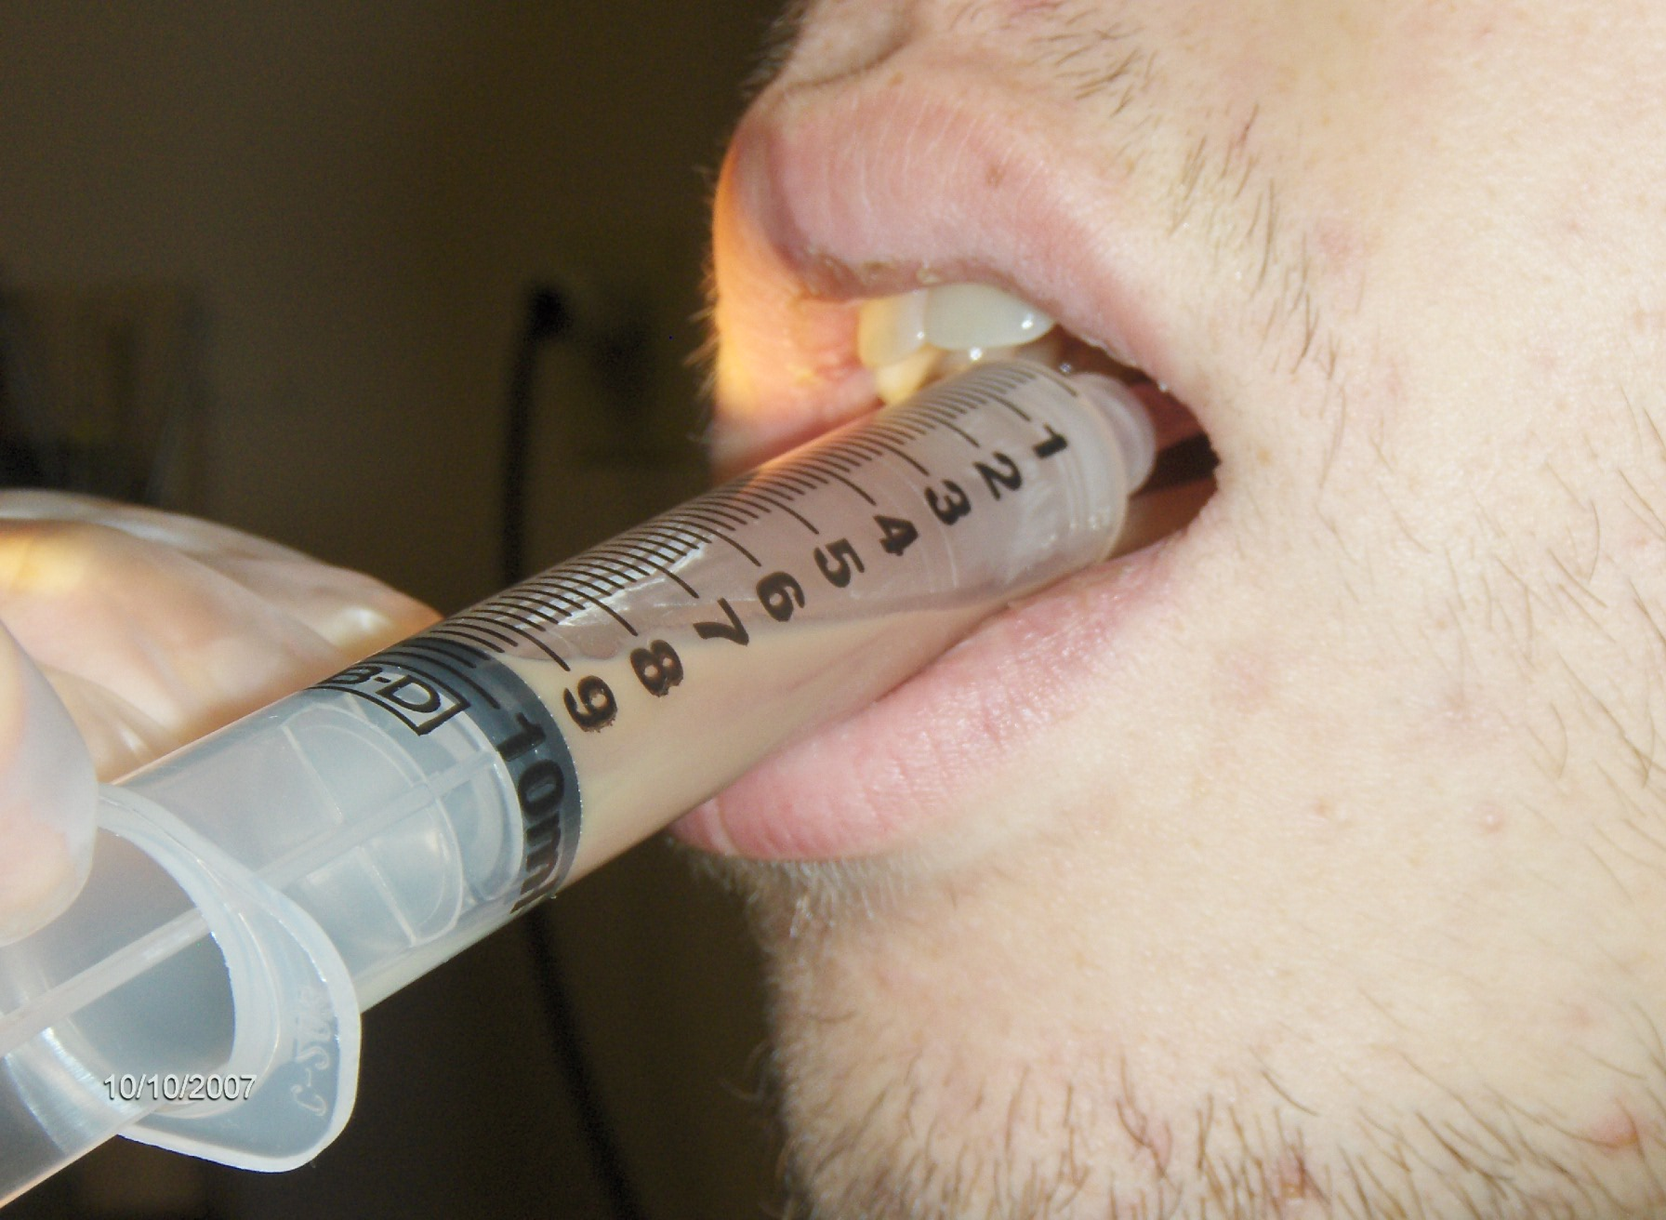
Treatment
Preferably admitted to hospital and treated with analgesics and antibiotics.
In a patient with an early peritonsillar abscess which is really a peritonsillar cellulitis incision and drainage are not recommended.

Slide 24
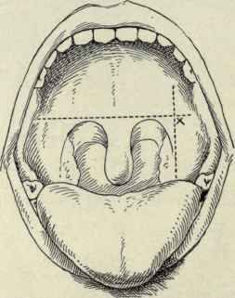
Indications for I/D include marked bulging of soft palate or failure of an assumed PTab to respond to adequate antibiotics. This is undertaken at the point of maximum bulge.
Interval tonsillectomy after 6 weeks.
Abscess tonsillectomy.

Slide 25
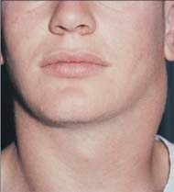
Complications
Quinsy is a potentially lethal condition
Pharyngeal & Laryngeal oedema
Parapharyngeal space abscess

